Slide 1
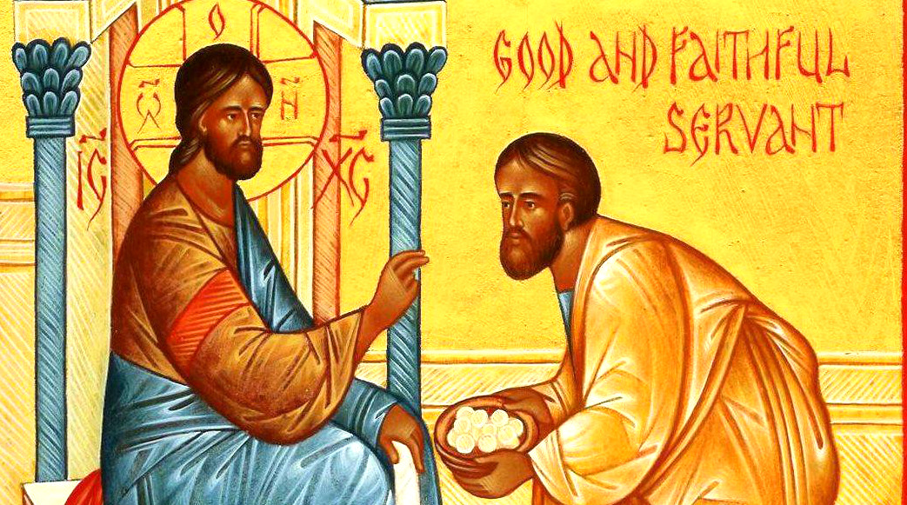
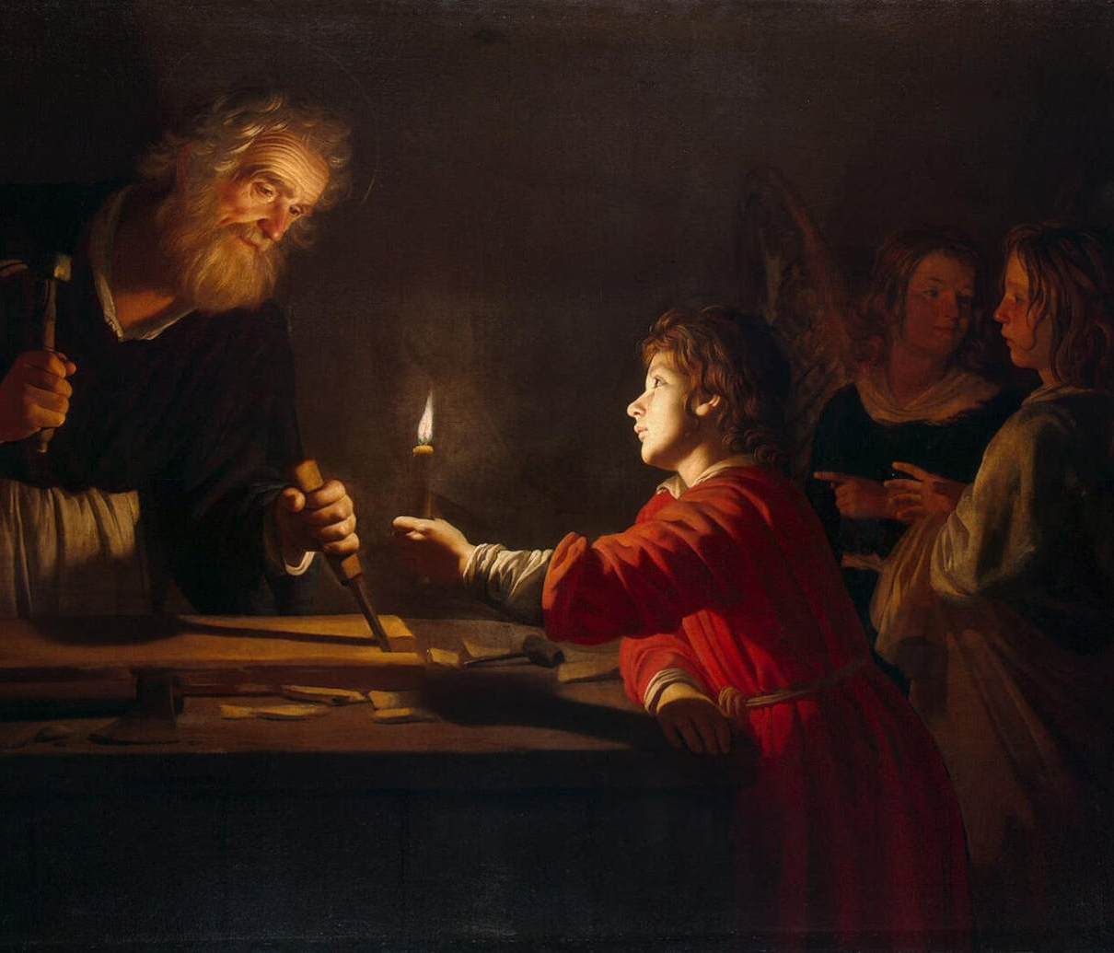
Parables: Class 2

Slide 2
Parables Series
June 8 – Parables About Who Belongs in the Kingdom
Good Samaritan, The Wedding Feast, Laborers in the Vineyard
June 22 – Parables About Growing the Kingdom
The Sower, Parable of the Talents, Light Under a Bushel
June 29 – Parables About Fulfilling the Kingdom
Prodigal Son, The Two Debtors, Great Banquet

Slide 3
What is the “Kingdom of God”?
After the Temple was rebuilt in 515 BCE, there were expanded hopes around God’s involvement in wider history well-beyond Israel’s borders
Isaiah 60 (along with much of Isaiah’s final chapters)
2 Chronicles 36:22-23
Daniel 7-12
Belief in a Messianic figure ushering that age in; of David’s lineage, ‘Son of Man’ tradition from Daniel

Slide 4
What is the “Kingdom of God”?
References to the “Kingdom” appear 162 times in NT
Kingdom of God = Kingdom of Heaven (?)
Kingdom of Heaven a unique term to Matthew’s Gospel
God taking back control of history from the powers of the day – whoever it might be (Babylon, Greece, Rome, etc.)
Already here… but has not fully come to fruition
Parable of the Mustard Seed – Matthew 13:31-32

Slide 5
What is the “Kingdom of God”?
Is the Kingdom of God an outward reality?
Mark 9:1 – “Truly I tell you, there are some standing here who will not taste death until they see that the Kingdom of God has come with power”
Matthew 5 Beatitudes… speaking to present or future??
Is the Kingdom of God an inward reality?
Luke 17:20-21 – “Once Jesus was asked by the Pharisees when the kingdom of God was coming, and he answered, ‘The Kingdom of God is not coming with things that can be observed; nor will they say, ‘Look here it is!’ or ‘There it is!’ For, in fact, the Kingdom of God is among you.”

Slide 6
What is the “Kingdom of God”?
Jesus’ arrival means that the Kingdom – however it is conceived of – is near:
Mark 1:15 – “The time is fulfilled, and the Kingdom of God has come near; repent and believe in the good news”.
Matthew 6:33 – “Strive first for the Kingdom of God and his righteousness, and all these things will be given to you as well”
What is our responsibility in helping usher this new era in?

Slide 7
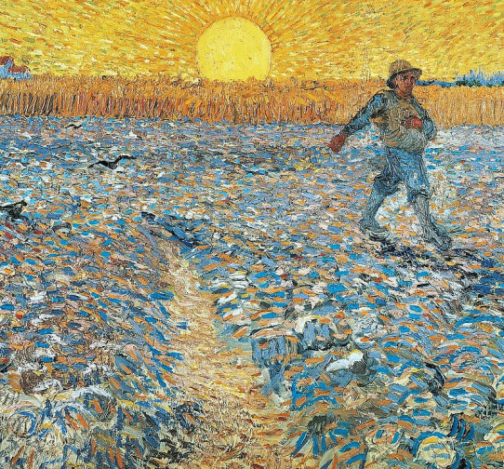
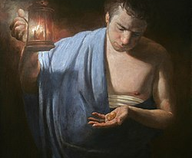
Who is responsible for growing God’s Kingdom? Parable of the Sower Parable of the Talents Parable of the Lamp under a Basket

Slide 8
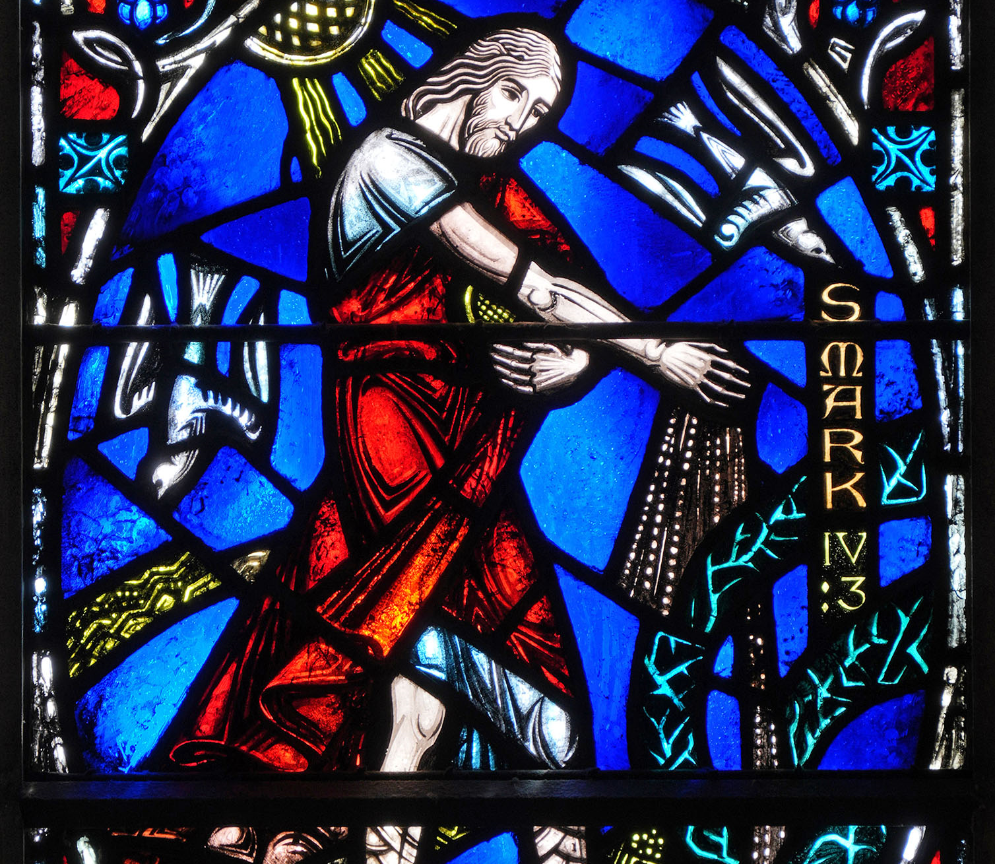
The Parable
of the Sower
Mark 4:1-9
Matthew 13:1-9
Luke 8:4-8

Slide 9
Parable of the Sower
One of eight parables to appear in all three Synoptic Gospels (Sower, Strong Man, New Wine/Old Wineskins, Lamp Under Basket, Mustard Seed, Wicked Tenants, Fig Tree, and Faithful Servant)
Agrarian imagery would be been quite familiar to many in Jesus’ audience
The only parable to receive an explanation from Jesus!

Slide 10
Parable of the Sower
Framing the Parable
Jesus’ teachings clashing with the Pharisees and others
Lamp under Bushel, Growing Seed, Mustard Seed
Scriptural Allusions
Isaiah 6:9-10 – Disbelief in God’s Word
“They may indeed look, but not perceive, and may indeed listen, but not understand; so that they may not turn again and be forgiven”
Genesis 26:12 – Hundredfold yield for Isaac

Slide 11
Parable of the Sower
Jesus’ summary of the parable’s meaning:
The Sower = one who sows God’s word
Seed on the Path = God’s word never takes root
Seed on Rocky Ground = God’s word initially takes root, but “trouble and/or persecution” makes them fall away
Seed on Thorns = God’s word takes root, but “cares of the world and lure of wealth” makes them fall away
Seed on Good Soil = God’s word takes root and produces grain, “yielding thirty and sixty and a hundredfold”

Slide 12
Parable of the Sower
Sower as Christ
Path = Pharisees / outright rejection from hometown, etc.
Rocky = those who flee, similar to Peter after Christ’s arrest
Thorns = those like Judas, who follow money vs. God’s kingdom
Good Soil = those who became Apostles in early church
Sower as 1st Century Disciples
We are the Sower rather than the Soil
We, like the parable, do not predetermine where we share seed (God’s word) – we share it freely and God will do the rest

Slide 13
Parable of the Sower
Reframing our desire to categorize what type of “soil”:
John Chrysostom – “How is it according to reason to sow seed among thorns, or on stony ground, or by the wayside? Indeed in the material seed and soil of this world it would not be reasonable; for it is impossible that rock should become soil, or that the way should not be the way, or that thorns should not be thorns. But with minds and doctrines it is otherwise; there it is possible that the rock be made rich soil, that the way should be no more trodden upon, and that the thorns should be extirpated. That the most part of the seed then perished, came not of him that sowed, but of the soil that received it, that is the mind. For He that sowed put no difference between rich and poor, wise or foolish, but spoke to all alike.

Slide 14
Parable of the Sower
Growth of the Early Church – impossible to pinpoint, but the following are estimates by century:
Earliest church – Acts states 120 people in Acts 1:15
By 100 CE – less than 10,000 (0.017% of Roman population)
200 CE – 200,000 (0.36% of Roman population)
250 CE – over 1,000,000 (around 2% of Roman population)
300 CE – over 6,000,000 (over 10% of Roman population)

Slide 16
Parable of the Talents
Found in both Matthew and Luke’s Gospels, but there are significant differences in where they appear
Matthew – Matthew 25, “Sheep and the Goats”
Luke – Luke 19, Zacchaeus and entry into Jerusalem
Talent does not refer to a skill – it was a very large sum of money (roughly 6,000 denarii, or 80 pounds of silver)
Great Reversal… but not in the way the Gospels usually depict it, adding to a sense of anxiety

Slide 17
Parable of the Talents
Historic Interpretations
Jesus speaking to the Apostles specifically
Meant to use their varying degrees of responsibility and influence to spread faith across the Roman Empire and beyond
Jesus speaking to every disciple
Similar to “Many Gifts, One Spirit” from 1 Corinthians 12 – all of us have a role to play in bringing God’s kingdom into being… no exceptions
Reflection on the religious leaders of Jesus’ day

Slide 18
Parable of the Talents
“From those who have nothing, even what they have will be taken away”…
An incredibly unsatisfying and troubling end to the parable when you read it at face value!
Appears in the explanation about the Light under the Bushel as well
Is not a reference to physical possessions – which is of paramount interest to Luke – but instead a reference to one’s faith
Likely a relationship with “you cannot serve both God and wealth”

Slide 19
Parable of the Talents
Gospel of Luke’s similarities… and differences
Matthew = Ten “Talents” (6,000 dn); Luke = Ten “Minas” (75 dn)
Ten servants (though only three speak)
Ending words “from those who have nothing, even what they have will be taken away” are the same – but Luke adds on “But as for these enemies of mine who did not want me to be king over them – bring them here and slaughter them in my presence” (?!?)
Not only about disciples – but expanded to Jerusalem and religious leaders too? Particularly in context of Jesus’ entry into the city

Slide 21
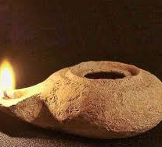
Parable of the Lamp under a Bushel
Appears in all three Gospels – although not as clear of a parable in Matthew when sharing in Sermon on Mount
Immediately follows the Parable of the Sower in Mark and Luke’s texts – seem to be interrelated concepts

Slide 22
Parable of the Lamp under a Bushel
Frequent metaphor used in the OT
2 Samuel 21:17 – speaking to David, “ you shall not go out to battle with us any longer so you do not quench the lamp of Israel”
Psalm 119:105 – “your word is a lamp to my feet”
Zechariah 4:2 – “I see a lampstand all of gold”
Bushel Basket
“Bushel” comes from the English translation done by William Tyndale; the Greek is a specific type of measurement basket

Slide 23
Parable of the Lamp under a Bushel
Historic Interpretations
The readily apparent one: we are meant to share our gifts!
Connection between this passage and the Parable of the Talents – don’t hold back what we have been given to share
Matthew 5:16 – “In the same way let your light shine before others, so that they may see your good works and give glory to your Father in heaven”
Jesus’ light is one of revelation
Mark 4:22 – “For there is nothing hidden, except to be disclosed; nor is there anything secret, except to come to light”

Slide 24
Parable of the Lamp under a Bushel
Later Interpretations
Jesus’ message meant to carry beyond Jerusalem
A 16th century Jesuit named Cornelius a Lapide stated that the parable was encouraging the Apostles to bring Christ’s message beyond the limits of Jerusalem
The church is meant to be a shining light
“We are a Light in the City, reflecting the inclusive love of God…”

Slide 25
Who is responsible for growing God’s Kingdom? Parable of the Sower Parable of the Talents Parable of the Lamp under a Basket

Slide 26
Who Is Responsible for Growing God’s Kingdom?
Parable of the Sower
We sow seeds of love, acceptance, grace, hope regardless of whether or not we expect them to take root
Parable of the Talents
We share what God has given to us, understanding the immense responsibility that we hold as a follower of Jesus
Parable of the Lamp under a Basket
From those in the earliest days of the church, to whatever that looks like in our contexts now, we share God’s light and love

Slide 27
Parables Series
June 8 – Parables About Who Belongs in the Kingdom
Good Samaritan, The Wedding Feast, Laborers in the Vineyard
June 22 – Parables About Growing the Kingdom
The Sower, Parable of the Talents, Light Under a Bushel
June 29 – Parables About Fulfilling the Kingdom
Prodigal Son, The Two Debtors, Great Banquet

